Slide 1
Improving Heart Failure Prediction Accuracy with PCA and Information Gain in Machine Learning Models
Student Name: Aleena Antoo
Student ID : 23035205

Slide 2
Introduction
This research explores how machine learning can predict heart failure risk using clinical and non-clinical parameters, applying PCA and IG for feature selection.

Slide 3

Research Aim
To enhance heart failure prediction accuracy using machine learning models by applying PCA and Information Gain for feature selection, enabling early diagnosis and improved treatment outcomes.

Slide 4
Research Questions
Which feature selection method (Principal Component Analysis (PCA) or Information Gain (IG)) enhances the performance of heart failure prediction models?
Which combination of machine learning algorithms and feature selection techniques (PCA and IG) leads to a more reliable and early prediction of heart failure risk?

Slide 5
Project Objectives
To collect and pre-process heart failure datasets from sources from Kaggle.
To apply PCA and Information Gain for feature selection on pre-processed dataset.
To design various machine learning algorithms such as Logistic Regression, Naive Bayes, Random Forest, K-Nearest Neighbor, and Decision Tree for heart failure prediction and compare its performance with and without feature selection.
To assess the impact of PCA and IG on model performance in heart failure prediction, focusing on accuracy, precision, recall, F1-score, and AUC-ROC.
To identify the optimal combination of feature selection method and machine learning model for heart failure prediction accuracy and reliability.

Slide 6
Project Plan
Task | Details | Start Date | End Date
Project Planning | Define objectives, select dataset, submit proposal. | 23/01/2025 | 27/01/2025
Initial Supervision | Discuss research focus and confirm dataset. | 27/01/2025 | 02/02/2025
Background Research | Review heart failure prediction studies and ML methods. | 03/02/2025 | 23/02/2025
Project & Data Management Plan | Prepare PDM document and presentation. | 06/02/2025 | 10/02/2025
Supervisory Feedback | Discuss project roadmap and improvements. | 10/02/2025 | 16/02/2025
Ethical Compliance | Review ethical guidelines and prepare for assessment. | 17/02/2025 | 20/03/2025
Literature Review Draft | Submit and refine literature review with feedback. | 24/02/2025 | 02/03/2025
Data Processing | Clean, encode, and normalize data; perform EDA. | 03/03/2025 | 09/03/2025
Feature Selection | Apply PCA and IG for dataset refinement. | 10/03/2025 | 16/03/2025
Ethics Quiz Submission | submit the ethics assessment. | 20/03/2025 | 20/03/2025
Pre-Implementation Review | Discuss preliminary implementation and challenges. | 24/03/2025 | 30/03/2025
Model Implementation | Build models like Logistic Regression, Naïve Bayes, etc. | 31/03/2025 | 06/04/2025
Training & Tuning | Train models, optimize hyperparameters, evaluate. | 07/04/2025 | 13/04/2025
Draft Report Discussion | Submit draft report and refine analysis. | 14/04/2025 | 20/04/2025
Model Validation & Interpretation | Compare models, analyze metrics, document findings. | 21/04/2025 | 27/04/2025
Final Report Submission | Submit completed research report. | 28/04/2025 | 29/04/2025
Presentation & Examination | Prepare and attend viva session. | 30/04/2025 | 13/05/2025

Slide 7
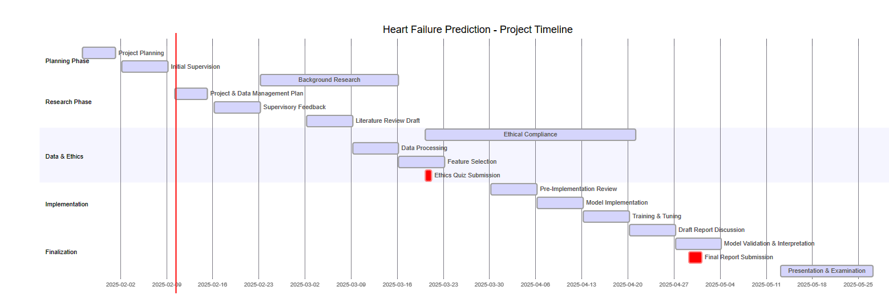
Gantt Chart

Slide 8
Methodology
Data Collection: Kaggle dataset.
Data Preprocessing: Handling missing values, normalization, encoding.
Feature Selection: PCA for dimensionality reduction, IG for ranking features.
Model Training: Logistic Regression, Naive Bayes, Random Forest, KNN, Decision Tree.
Model Evaluation: Accuracy, Precision, Recall, F1-score, AUC-ROC.

Slide 9
Dataset Overview
Data Collection: The dataset will be downloaded from Kaggle
Dataset Link: https://www.kaggle.com/datasets/fedesoriano/heart-failure-prediction
918 observations, 12 attributes.
Derived from 5 medical datasets (Cleveland, Hungarian, Switzerland, Long Beach VA, Stalog).
Clinical measures: Age, BP, Cholesterol, ECG results, etc.

Slide 10
Dataset Overview
The dataset is provided as a 35.92 kB CSV file, containing 11 clinical attributes related to cardiovascular disease risk and one target variable for classification.
The dataset and code will be stored on GitHub, with regular backups to an online cloud storage system. Access to the repository will be restricted to project staff and authorized reviewers only.
Github Link : https://github.com/Aleena3443/Improving-Heart-Failure-Prediction-Accuracy-with-PCA-and-Information-Gain-in-Machine-Learning-Models.git

Slide 11
Ethical Requirements
The dataset adheres to ethical standards through fully anonymized medical data, complying with GDPR requirements.
It originates from reputable hospitals (Hungarian Institute of Cardiology, University Hospitals of Zurich and Basel, Cleveland Clinic).
The Open Database License permits free research use, while credited medical professionals ensure ethical collection standards.

Slide 12
Model Performance Comparison
ML models compared with and without PCA & IG.
Metrics: Accuracy, Precision, Recall, F1-score, AUC-ROC.
Best-performing model determined based on predictive accuracy.

Slide 13
Expected Outcomes
PCA and IG improve prediction accuracy.
Some models perform better with PCA, others with IG.
Identifies the optimal feature selection technique for heart failure prediction.

Slide 14


